Slide 1
The Roads to Nicaea:
Who Came and
Why?
Glen L. Thompson, Asia Lutheran Seminary
https://www.fourthcentury.com/council-of-nicaea-ad-325/

Slide 2
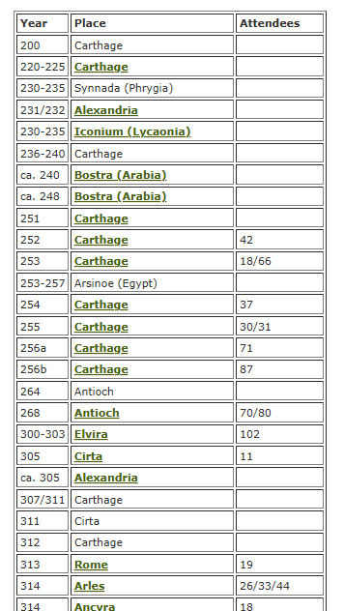
https://www.fourthcentury.com/councils-and-creeds/

Slide 3
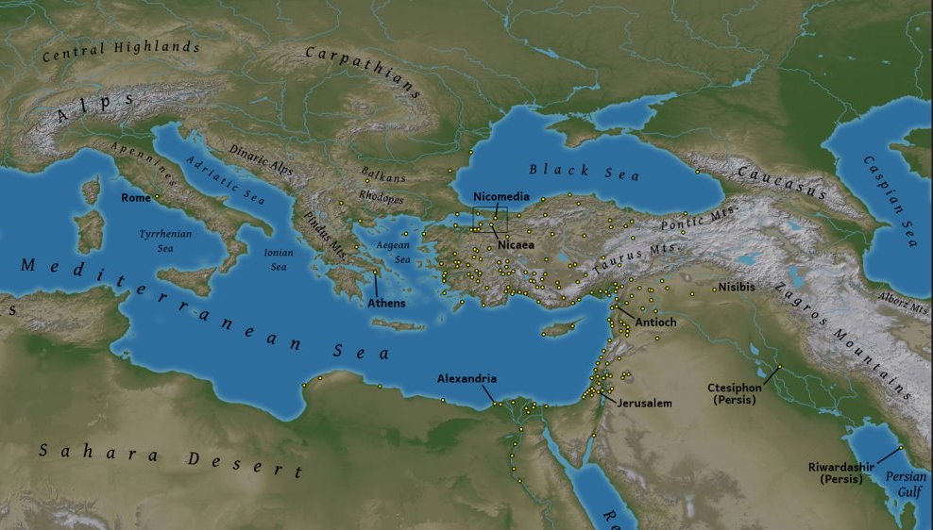

Slide 4
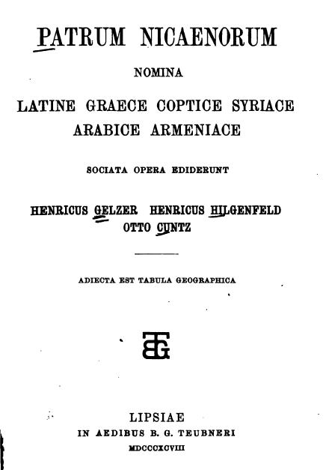
“If we read the Acts [acta] and the names of the bishops of the Council of Nicaea, we find that those
to whom we referred to above were welcomed back and did subscribe to the homoousion along with
the rest.”
Jerome, Dialogue against the Luciferians (c. 380)
“As I imagine it will be appreciated by lovers of learning, I shall here add on the names of those who were present [at the council], as far as I have been able to ascertain them, with the province and city over which they presided, …”
Socrates, Church History (1.13.11)

Slide 5
Province
1. “West” | 2
2. Egypt | 12
3. Thebes | 3
4. Libya | 5
5. Palestine | 19
6. Phoenicia | 10
7. Coele-Syria | 22
8. Arabia | 6
9. Mesopotamia | 4
10. Persia | 1
11. Cilicia | 10
12. Cappadocia | 10
13. Lesser Armenia | 2
14. Greater Armenia | 5
15. Pontus | 3
16. Paphlagonia | 3
17. Galatia | 5
18. Asia | 7
19. Lydia | 9
20. Phrygia | 8
21. Pisidia | 8
Province
22. Lycia | 2
23. Pamphylia | 7
24. Islands | 4
25. Caria | 5
26. Isauria | 18
27. Cyprus | 2
28. Bithynia | 11
29. Europe | 1
30. Dacia | 1
31. Moesia | 1
32. Macedonia | 2
33. Hellas | 3
34. Thessalia | 2
35. Calabria | 1
36. Africa Procon. | 1
37. Dardania | 1
38. Dalmatia | 1
39. Pannonia | 1
40. Galliae | 1
41. Gothia | 1
42. Bosphorus | 1
Notes:
outdated

Slide 6
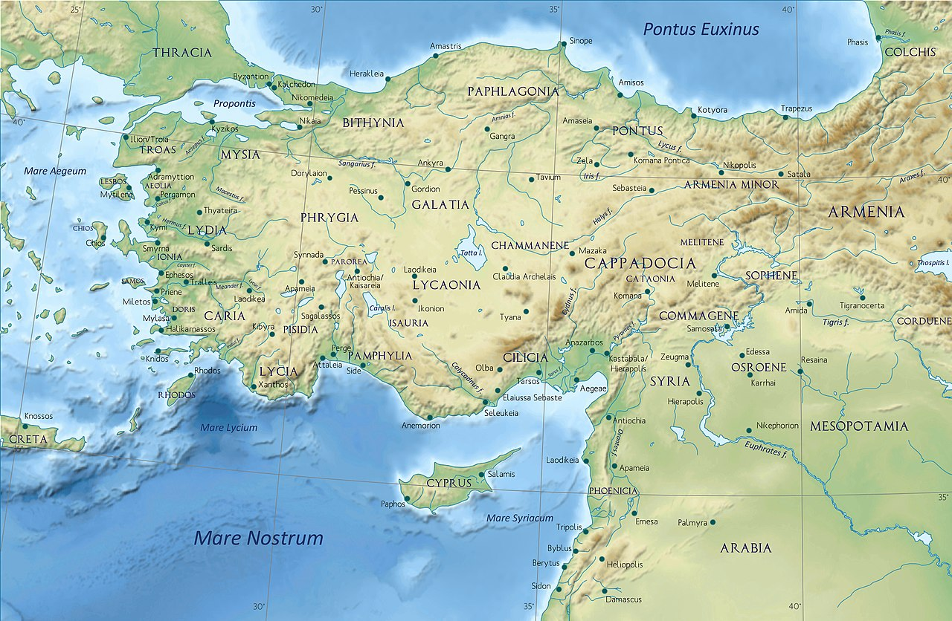
Paphlagonia
3
Bithynia11
Pontus
3
Phrygia
8
Galatia
5
Lydia
8
Cappadocia
10
Asia
7
Pisidia
14
Isauria
18
Caria
4
Pamphylia
7
Cilicia
10
Lycia
1
Coele-Syria
22
Anatolia/Turkey: 109 = 49%
Palestine/Syria: 53 = 24%
Phoenicia
10
Cyprus
2
Palestine
19
Notes:
updated Dec 20

Slide 7
Province |  | %
Coele-Syria | 22 | 11.0
Palestine | 19 | 9.5
Isauria | 17 | 8.5
Egypt + Thebes | 16 | 8.0
Bithynia | 11 | 5.5
Phoenicia | 10 | 5.0
Cilicia | 10 | 5.0
Cappadocia | 10 | 5.0
Lydia | 9 | 4.5
Phrygia | 8 | 4.0
Pisidia | 8 | 4.0
Asia | 7 | 3.5
Pamphylia | 7 | 3.5
Arabia | 6 | 3.0
Province |  | %
Galatia | 5 | 2.5
Greater Armenia | 5 | 2.5
Libya | 5 | 2.5
Caria | 5 | 2.5
Mesopotamia | 4 | 2.0
Islands | 4 | 2.0
Pontus Polemon. | 3 | 1.5
Paphlagonia | 3 | 1.5
Hellas | 3 | 1.5
“West” | 3 | 1.5
Lesser Armenia | 2 | 1
Cyprus | 2 | 1
Macedonia | 2 | 1
Thessalia | 2 | 1
Province | total | %
Persia | 1 | 0.5
Lycia | 1 | 0.5
Europa | 1 | 0.5
Dacia | 1 | 0.5
Moesia | 1 | 0.5
Calabria | 1 | 0.5
Africa Procons. | 1 | 0.5
Dardania | 1 | 0.5
Dalmatia | 1 | 0.5
Pannonia | 1 | 0.5
Galliae | 1 | 0.5
Gothia | 1 | 0.5
Bosphorus | 1 | 0.5
Total | 221
Most well-represented provinces
at Nicaea (325)

Slide 8
Isauria/Bithynia/Cilicia/Cappadocia/Lydia/Phrygia/Pisidia/Asia/ Pamphylia/Galatia/Caria/Lycia/Paphlagonia/Pontus | 104 | 47%
Syria/Phoenicia/Palestine/Cyprus | 53 | 24%
Egypt/Thebes/Libya | 21 | 10%
Hellas/Macedonia/Thessaly/Islands | 11 | 5%
Arabia/Mesopotamia/Persia | 11 | 5%
Greater/Lesser Armenia | 7 | 4%
Europa/Goths/Bosporus | 3
Dacia/Moesia/ Dalmatia/Pannonia/Dardania | 5 | 5%
Spain/ Gaul/Rome/ Calabria/Africa | 6
Total | 221
Language of Participants
Greek = 90%
Latin = 5%
Syriac? = 5%

Slide 9
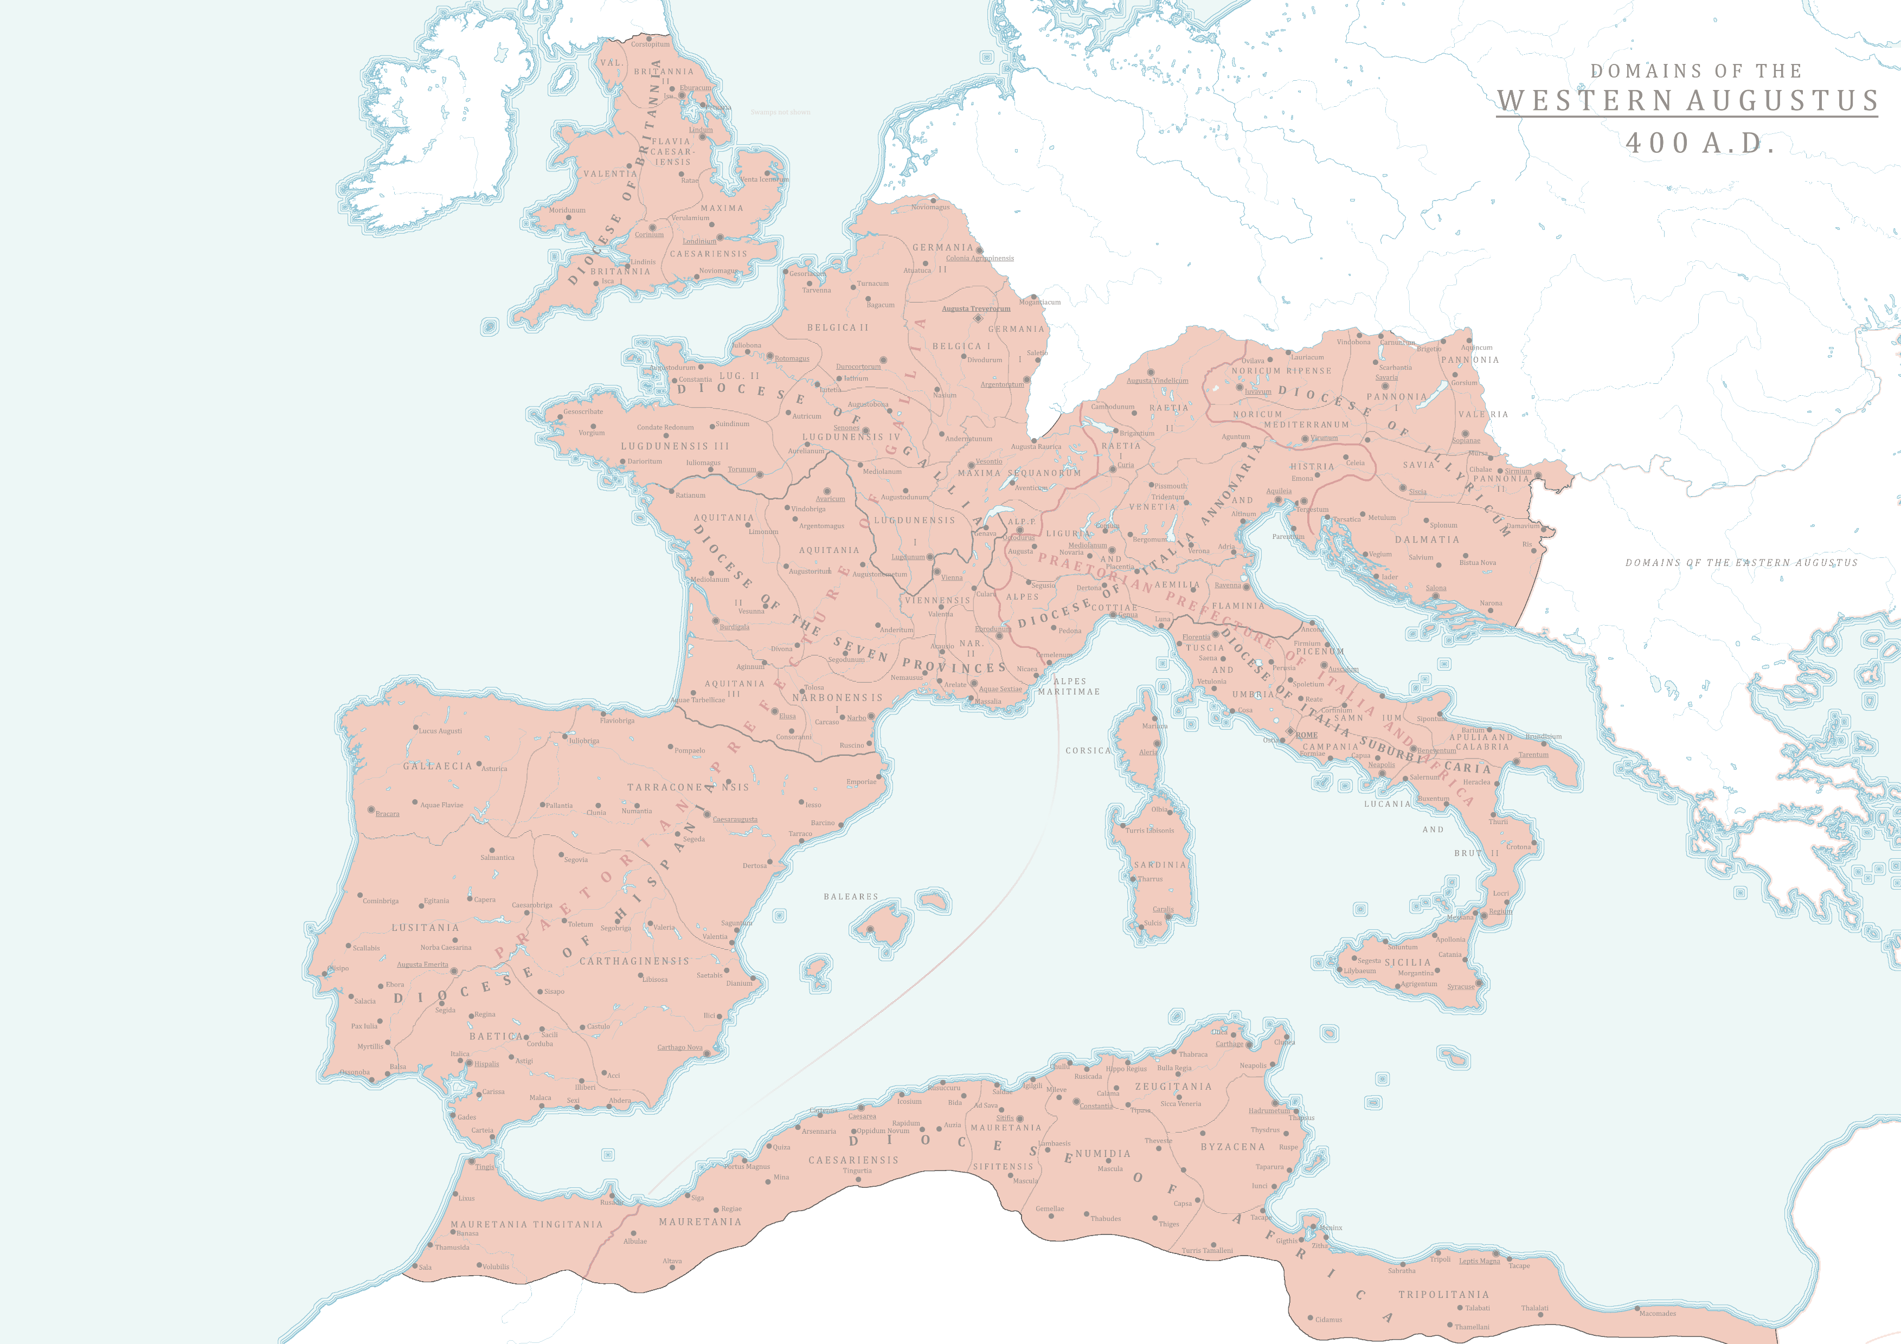
Pannonia
1
Moesia
1
Dacia
1
Dalmatia
1
LATIN
Danube area: 5
Africa and West: 6 = 5%
Dardania
1
Gallia
1
Roma
(2)
Calabria
1
Hispania
1
Africa
1

Slide 10
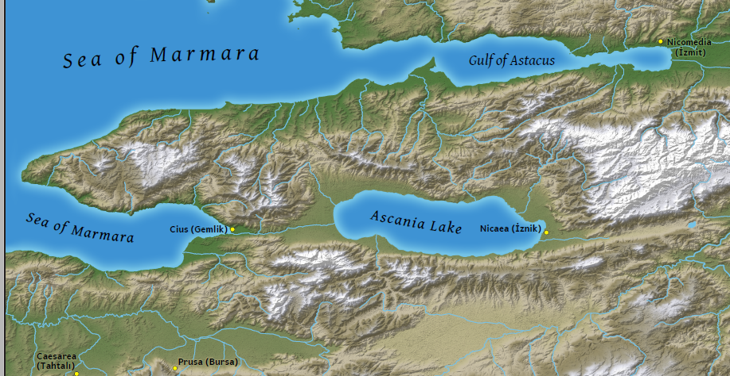

Slide 11
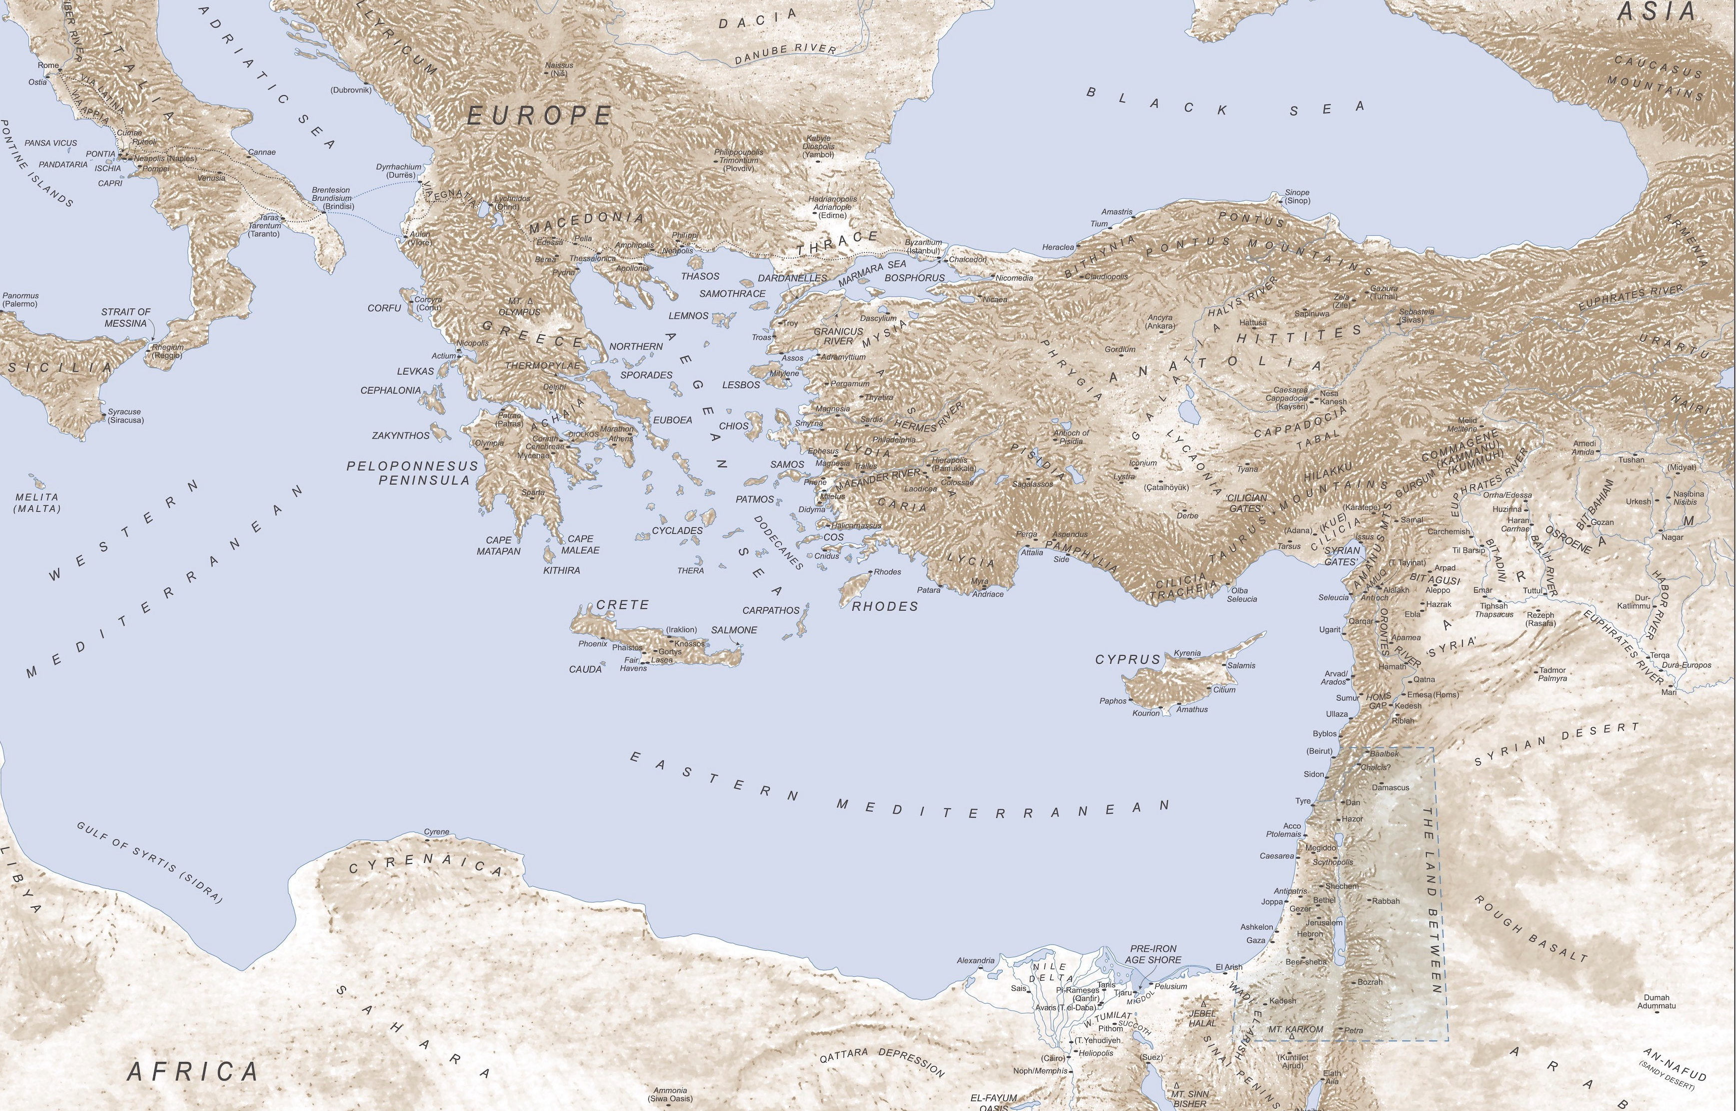
Gothia
1
Bosporus
1
Greater Armenia
5
Macedonia
2
Europa1
Thessaly
2
Lesser Armenia
2
Achaea
3
Islands
4
Mesopotamia
4
Egypt/Libya: 21 = 10%
Arabia/Mesopot. 11 = 5%
Greater Greece: 11 = 5%
Armenia: 7 = 3%
Black Sea: 3 = 1%
Persia
1
Libya
5
Egypt/Thebes
16
Arabia
6

Slide 12
Paphlagonia
3
Bithynia11
Pontus
3
Phrygia
8
Galatia
5
Lydia
8
Cappadocia
10
Asia
7
Pisidia
14
Isauria
18
Caria
4
Pamphylia
7
Cilicia
10
Lycia
1
Coele-Syria
22
Phoenicia
10
Cyprus
2
Anatolia/Turkey: 109 = 49%
Palestine/Syria: 53 = 24%
Palestine
19
Notes:
updated Dec 20

Slide 13
“Arianizers”
320-325
(28 clergy)
Bithynia
3
Pontus
2
Armenia
2
Asia
1
Cappadocia
1
Cilicia
5
Coele-Syria
2
Phoenicia
2
Egypt/Libya
7
Palestine
3
Notes:
“47 of the 53 [56] bishops named can be assigned to dioceses in the patriarchate of Antioch with a fair degree of confidence.” – David Wilmshurst
45 of these 56 were also at Nicaea. [my count] - 43 from 4 areas that had 61 bishops at Nicaea

Slide 14
Council of Antioch
324/325
rev.
(49 of 57 bishops)
Cappadocia
1
Isauria
2
Mesopotamia
1
Cilicia
10
Coele-Syria
16
Cyprus
1?
Phoenicia
6
Palestine
14
Arabia
1
Notes:
not counting Hosius, 47 of 55 (Wilmshurst), or 49 of 57 (Simperl) were at Nicaea; almost all “can be assigned to dioceses in the patriarchate of Antioch with a fair degree of confidence.” – David Wilmshurst
[I added 3 who didn’t sign at Antioch].

Slide 15
Province | Bishops | Chorep.
Coele-Syria | 20 | 2
Isauria | 13 | 5
Bithynia | 9 | 2
Cilicia | 9 | 1
Cappadocia | 5 | 5
Chorepiscopi at Nicaea (325)

Slide 16
10. Sardica
1. Rome
12. Marcionopolis
8. Thessalonica
13. Constantinople
7. Cyzicus
13 bishops: “All these holy apostolic men delivered the decisions of the holy great ecumenical synod of Nicaea to all the holy churches of God under heaven and brought them to all parts of the world…. (Gelasius, Fr. 14)
6. Caesarea (Capp.)
9. Laodicea
4. Antioch
5. John the Persian
11. Carthage
3. Jerusalem/
Caesarea
2. Alexander

Slide 17
https://www.fourthcentury.com/council-of-nicaea-ad-325/

